Slide 1
LEARNING INTENTIONS
Examine how governments act to improve economic performance
Examine ways that governments support business to increase productivity

Slide 2
Success Criteria
Outline what productivity means. List ways that governments support businesses to increase productivity. Outline why training and development are important factors in improving economic performance.

Slide 3
Recall: what measures what can be produced (output) from a given amount of input?

Slide 4
Recall: what measures what can be produced (output) from a given amount of input?
PRODUCTIVITY

Slide 5

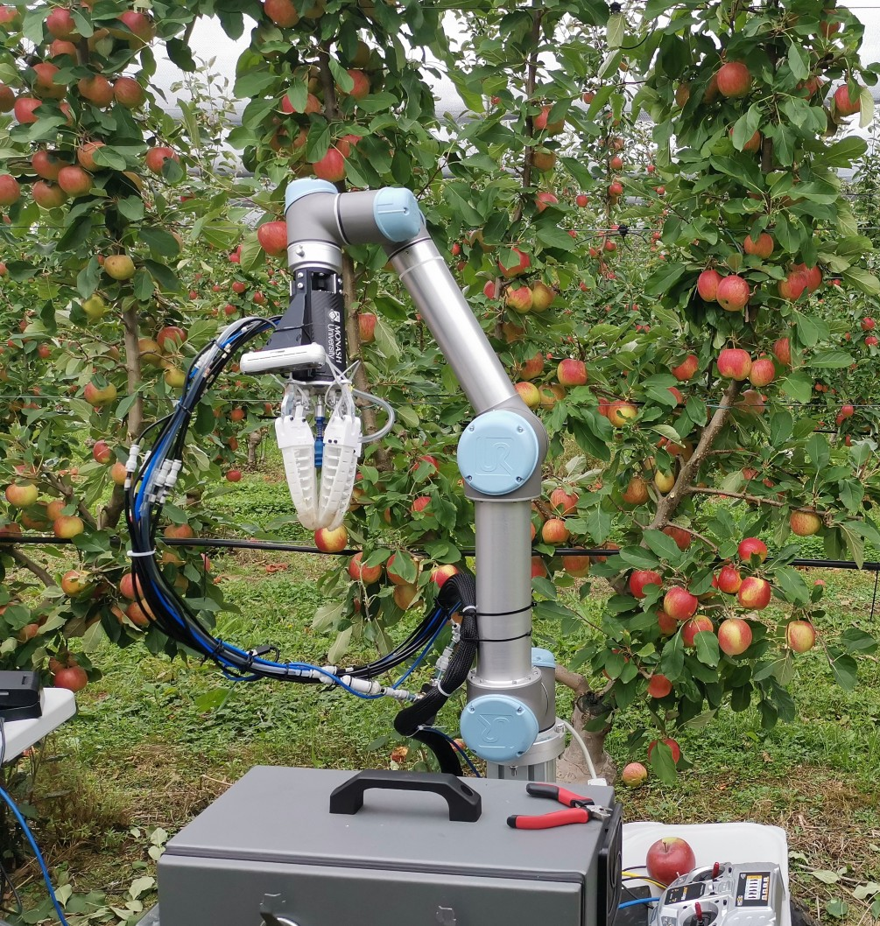


Slide 6


Slide 7

Use fewer of these resources (inputs)
To produce
Labour
The same quantity
Capital
OR
Natural Resources
Greater quantity

Slide 8
A business can increase its productivity by using its labour and capital resources more effectively and improving its business processes

Slide 9
Read about Labour and Capital Productivity

Slide 10
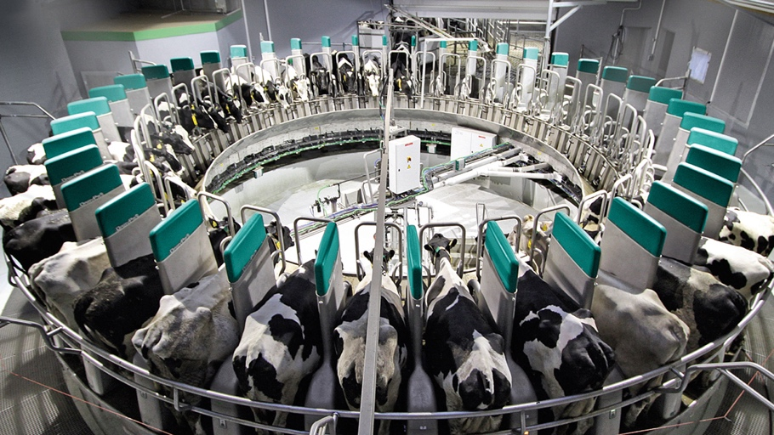
https://www.youtube.com/watch?v=JgeVk41bTVI
The Finlayson family from Tagori, Tasmania adopted an Automatic Milking System that helped them to do their job more efficiently and increased their herd production by 10 %

Slide 11

https://www.youtube.com/watch?v=6EkxVw9TcSk

Slide 12
Complete the activities in your HASS notes

